Slide 1
UNIT – VI Distributed Databases
Mr. S. L. Dhende
Notes:
1

Slide 2
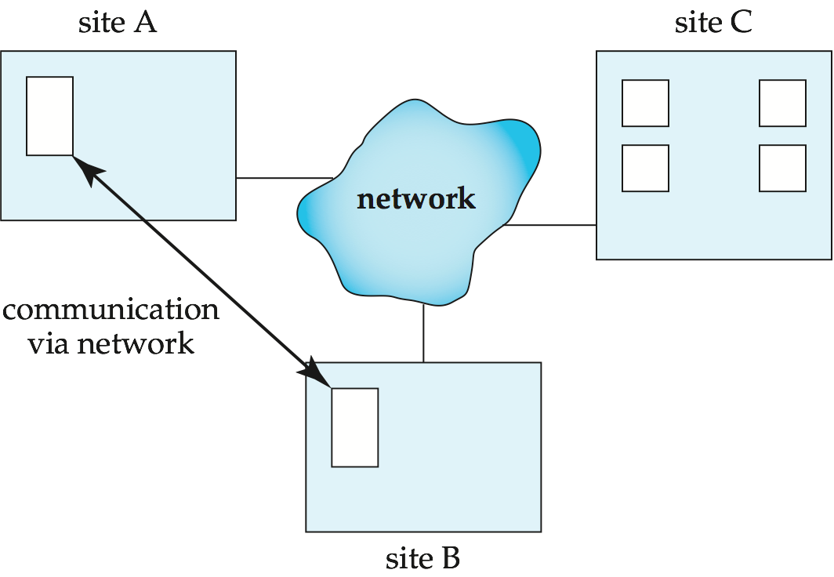
Distributed Systems
Data spread over multiple machines (also referred to as sites or nodes).
Network interconnects the machines
Data shared by users on multiple machines
Notes:
2

Slide 3
Distributed Systems
A distributed database system consists of loosely coupled sites that share no physical component.
Database systems that run on each site are independent of each other.
Transactions may access data at one or more sites
Notes:
3

Slide 4
Types of Distributed Databases
In a homogeneous distributed database
All sites have identical software
Are aware of each other and agree to cooperate in processing user requests.
Each site surrenders part of its autonomy in terms of right to change schemas or software
Appears to user as a single system
In a heterogeneous distributed database
Different sites may use different schemas and software
Difference in schema is a major problem for query processing
Difference in software is a major problem for transaction processing
Sites may not be aware of each other and may provide only limited facilities for cooperation in transaction processing
Notes:
4

Slide 5
Distributed Databases
Homogeneous distributed databases
Same software/schema on all sites, data may be partitioned among sites
Goal: provide a view of a single database, hiding details of distribution
Heterogeneous distributed databases
Different software/schema on different sites
Goal: integrate existing databases to provide useful functionality
Differentiate between local and global transactions
A local transaction accesses data in the single site at which the transaction was initiated.
A global transaction either accesses data in a site different from the one at which the transaction was initiated or accesses data in several different sites.
Notes:
5

Slide 6
Trade-offs in Distributed Systems
Sharing data – users at one site able to access the data residing at some other sites.
Autonomy – each site is able to retain a degree of control over data stored locally.
Higher system availability through redundancy — data can be replicated at remote sites, and system can function even if a site fails.
Disadvantage: added complexity required to ensure proper coordination among sites.
Software development cost.
Greater potential for bugs.
Increased processing overhead.
Notes:
6

Slide 7
Implementation Issues for Distributed Databases
Atomicity needed even for transactions that update data at multiple sites
The two-phase commit protocol (2PC) is used to ensure atomicity
Basic idea: each site executes transaction until just before commit, and the leaves final decision to a coordinator
Each site must follow decision of coordinator, even if there is a failure while waiting for coordinators decision
2PC is not always appropriate: other transaction models based on persistent messaging, and workflows, are also used
Distributed concurrency control (and deadlock detection) required
Data items may be replicated to improve data availability
Notes:
7

Slide 8
Distributed Data Storage
Assume relational data model
Replication
System maintains multiple copies of data, stored in different sites, for faster retrieval and fault tolerance.
Fragmentation
Relation is partitioned into several fragments stored in distinct sites
Replication and fragmentation can be combined
Relation is partitioned into several fragments: system maintains several identical replicas of each such fragment.
Notes:
8

Slide 9
Data Replication
A relation or fragment of a relation is replicated if it is stored redundantly in two or more sites.
Full replication of a relation is the case where the relation is stored at all sites.
Fully redundant databases are those in which every site contains a copy of the entire database.
Notes:
9

Slide 10
Data Replication (Cont.)
Advantages of Replication
Availability: failure of site containing relation r does not result in unavailability of r is replicas exist.
Parallelism: queries on r may be processed by several nodes in parallel.
Reduced data transfer: relation r is available locally at each site containing a replica of r.
Disadvantages of Replication
Increased cost of updates: each replica of relation r must be updated.
Increased complexity of concurrency control: concurrent updates to distinct replicas may lead to inconsistent data unless special concurrency control mechanisms are implemented.
One solution: choose one copy as primary copy and apply concurrency control operations on primary copy
Notes:
10

Slide 11
Data Fragmentation
Division of relation r into fragments r₁, r₂, …, r_{n} which contain sufficient information to reconstruct relation r.
Horizontal fragmentation: each tuple of r is assigned to one or more fragments
Vertical fragmentation: the schema for relation r is split into several smaller schemas
All schemas must contain a common candidate key (or superkey) to ensure lossless join property.
A special attribute, the tuple-id attribute may be added to each schema to serve as a candidate key.
Notes:
11

Slide 12
Horizontal Fragmentation of account Relation
branch_name
account_number
balance
Hillside
Hillside
Hillside
A-305
A-226
A-155
500
336
62
account₁ = σ_{branch_name=“Hillside”} (account )
branch_name
account_number
balance
Valleyview
Valleyview
Valleyview
Valleyview
A-177
A-402
A-408
A-639
205
10000
1123
750
account₂ = σ_{branch_name=“Valleyview”} (account )
Notes:
12

Slide 13
Vertical Fragmentation of employee_info Relation
branch_name
customer_name
tuple_id
Hillside
Hillside
Valleyview
Valleyview
Hillside
Valleyview
Valleyview
Lowman
Camp
Camp
Kahn
Kahn
Kahn
Green
1
2
3
4
5
6
7
deposit₁ = Πbranch_name, customer_name, tuple_id (employee_info )
account_number
balance
tuple_id
A-305
A-226
A-177
A-402
A-155
A-408
A-639
500
336
205
10000
62
1123
750
1
2
3
4
5
6
7
deposit₂ = Πaccount_number, balance, tuple_id (employee_info )
Notes:
13

Slide 14
Advantages of Fragmentation
Horizontal:
allows parallel processing on fragments of a relation
allows a relation to be split so that tuples are located where they are most frequently accessed
Vertical:
allows tuples to be split so that each part of the tuple is stored where it is most frequently accessed
tuple-id attribute allows efficient joining of vertical fragments
allows parallel processing on a relation
Vertical and horizontal fragmentation can be mixed
Fragments may be successively fragmented to an arbitrary depth.
Notes:
14

Slide 15
Distributed Transactions
Transaction may access data at several sites.
Each site has a local transaction manager responsible for:
Maintaining a log for recovery purposes
Participating in coordinating the concurrent execution of the transactions executing at that site.
Each site has a transaction coordinator, which is responsible for:
Starting the execution of transactions that originate at the site.
Distributing subtransactions at appropriate sites for execution.
Coordinating the termination of each transaction that originates at the site, which may result in the transaction being committed at all sites or aborted at all sites.
Notes:
15

Slide 16
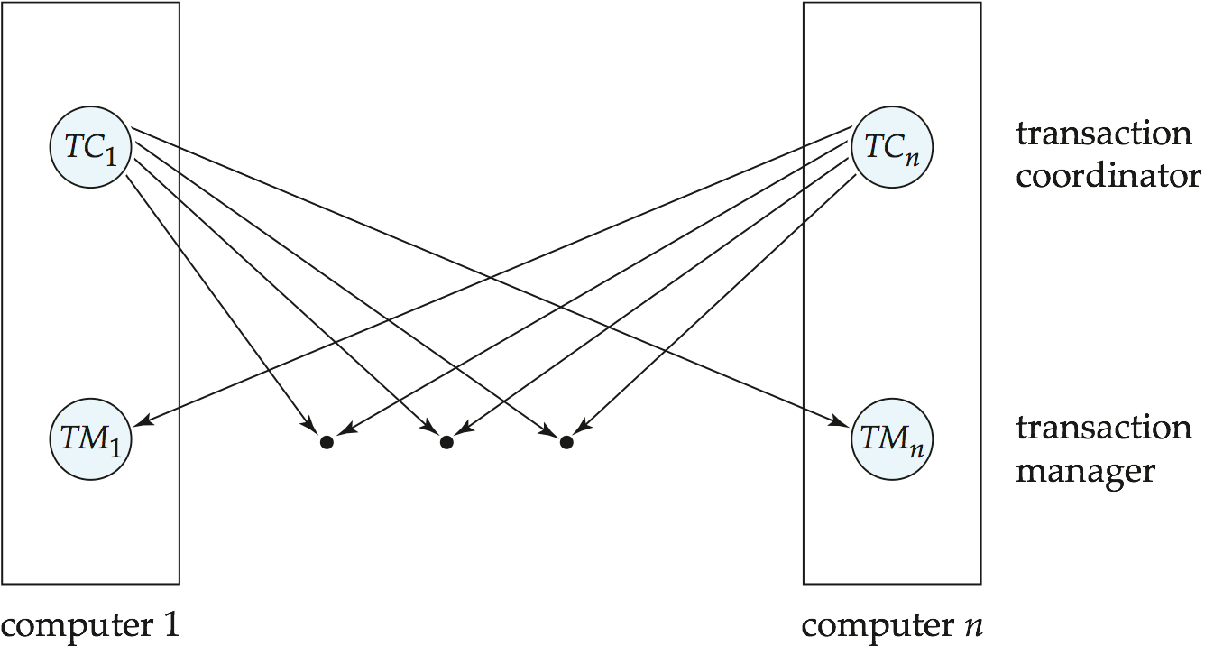
Transaction System Architecture
Notes:
16

Slide 17
System Failure Modes
Failures unique to distributed systems:
Failure of a site.
Loss of messages
Handled by network transmission control protocols such as TCP-IP
Failure of a communication link
Handled by network protocols, by routing messages via alternative links
Network partition
A network is said to be partitioned when it has been split into two or more subsystems that lack any connection between them
Note: a subsystem may consist of a single node
Network partitioning and site failures are generally indistinguishable.
Notes:
17

Slide 18
Commit Protocols
Commit protocols are used to ensure atomicity across sites
a transaction which executes at multiple sites must either be committed at all the sites, or aborted at all the sites.
not acceptable to have a transaction committed at one site and aborted at another
The two-phase commit (2PC) protocol is widely used
The three-phase commit (3PC) protocol is more complicated and more expensive, but avoids some drawbacks of two-phase commit protocol. This protocol is not used in practice.
Notes:
18

Slide 19
Two Phase Commit Protocol (2PC)
Assumes fail-stop model – failed sites simply stop working, and do not cause any other harm, such as sending incorrect messages to other sites.
Execution of the protocol is initiated by the coordinator after the last step of the transaction has been reached.
The protocol involves all the local sites at which the transaction executed
Let T be a transaction initiated at site S_{i}, and let the transaction coordinator at S_{i} be C_{i}
Notes:
19

Slide 20
Phase 1: Obtaining a Decision
Coordinator asks all participants to prepare to commit transaction T_{i}.
C_{i} adds the records <prepare T> to the log and forces log to stable storage
sends prepare T messages to all sites at which T executed
Upon receiving message, transaction manager at site determines if it can commit the transaction
if not, add a record <no T> to the log and send abort T message to C_{i}
if the transaction can be committed, then:
add the record <ready T> to the log
force all records for T to stable storage
send ready T message to C_{i}
Notes:
20

Slide 21
Phase 2: Recording the Decision
T can be committed of C_{i} received a ready T message from all the participating sites: otherwise T must be aborted.
Coordinator adds a decision record, <commit T> or <abort T>, to the log and forces record onto stable storage. Once the record stable storage it is irrevocable (even if failures occur)
Coordinator sends a message to each participant informing it of the decision (commit or abort)
Participants take appropriate action locally.
Notes:
21

Slide 22
2PC Disadvantages
Disadvantages:
The greatest disadvantage of the two-phase commit protocol is that it is a blocking protocol. If the coordinator fails permanently, some cohorts will never resolve their transactions: After a cohort has sent an agreement message to the coordinator, it will block until a commit or rollback is received.
Notes:
22

Slide 23
Three Phase Commit (3PC)
Assumptions:
No network partitioning
At any point, at least one site must be up.
At most K sites (participants as well as coordinator) can fail
Phase 1: Obtaining Preliminary Decision: Identical to 2PC Phase 1.
Every site is ready to commit if instructed to do so
Phase 2 of 2PC is split into 2 phases, Phase 2 and Phase 3 of 3PC
In phase 2 coordinator makes a decision as in 2PC (called the pre-commit decision) and records it in multiple (at least K) sites
In phase 3, coordinator sends commit/abort message to all participating sites,
Under 3PC, knowledge of pre-commit decision can be used to commit despite coordinator failure
Avoids blocking problem as long as < K sites fail
Drawbacks:
higher overheads
assumptions may not be satisfied in practice
Notes:
23

Slide 24
Alternative Models of Transaction Processing
Notion of a single transaction spanning multiple sites is inappropriate for many applications
E.g. transaction crossing an organizational boundary
No organization would like to permit an externally initiated transaction to block local transactions for an indeterminate period
Alternative models carry out transactions by sending messages
Code to handle messages must be carefully designed to ensure atomicity and durability properties for updates
Isolation cannot be guaranteed, in that intermediate stages are visible, but code must ensure no inconsistent states result due to concurrency
Persistent messaging systems are systems that provide transactional properties to messages
Messages are guaranteed to be delivered exactly once
Notes:
24

Slide 25
Alternative Models (Cont.)
Motivating example: funds transfer between two banks
Two phase commit would have the potential to block updates on the accounts involved in funds transfer
Alternative solution:
Debit money from source account and send a message to other site
Site receives message and credits destination account
Messaging has long been used for distributed transactions (even before computers were invented!)
Atomicity issue
once transaction sending a message is committed, message must guaranteed to be delivered
Guarantee as long as destination site is up and reachable, code to handle undeliverable messages must also be available
e.g. credit money back to source account.
If sending transaction aborts, message must not be sent
Notes:
25

Slide 26
Handling of Failures - Site Failure
When site S_{i} recovers, it examines its log to determine the fate of
transactions active at the time of the failure.
Log contain <commit T> record: txn had completed, nothing to be done
Log contains <abort T> record: txn had completed, nothing to be done
Log contains <ready T> record: site must consult C_{i} to determine the fate of T.
If T committed, redo (T); write <commit T> record
If T aborted, undo (T)
The log contains no log records concerning T:
Implies that S_{k} failed before responding to the prepare T message from C_{i}
since the failure of S_{k} precludes the sending of such a response, coordinator C₁ must abort T
S_{k} must execute undo (T)
Notes:
26

Slide 27
Handling of Failures- Coordinator Failure
If coordinator fails while the commit protocol for T is executing then participating sites must decide on T’s fate:
If an active site contains a <commit T> record in its log, then T must be committed.
If an active site contains an <abort T> record in its log, then T must be aborted.
If some active participating site does not contain a <ready T> record in its log, then the failed coordinator C_{i} cannot have decided to commit T.
Can therefore abort T; however, such a site must reject any subsequent <prepare T> message from C_{i}
If none of the above cases holds, then all active sites must have a <ready T> record in their logs, but no additional control records (such as <abort T> of <commit T>).
In this case active sites must wait for C_{i} to recover, to find decision.
Blocking problem: active sites may have to wait for failed coordinator to recover.

Slide 28
Handling of Failures - Network Partition
If the coordinator and all its participants remain in one partition, the failure has no effect on the commit protocol.
If the coordinator and its participants belong to several partitions:
Sites that are not in the partition containing the coordinator think the coordinator has failed, and execute the protocol to deal with failure of the coordinator.
No harm results, but sites may still have to wait for decision from coordinator.
The coordinator and the sites are in the same partition as the coordinator think that the sites in the other partition have failed, and follow the usual commit protocol.
Again, no harm results
Notes:
28

Slide 29
Recovery and Concurrency Control
In-doubt transactions have a <ready T>, but neither a <commit T>, nor an <abort T> log record.
The recovering site must determine the commit-abort status of such transactions by contacting other sites; this can slow and potentially block recovery.
Recovery algorithms can note lock information in the log.
Instead of <ready T>, write out <ready T, L> L = list of locks held by T when the log is written (read locks can be omitted).
For every in-doubt transaction T, all the locks noted in the <ready T, L> log record are reacquired.
After lock reacquisition, transaction processing can resume; the commit or rollback of in-doubt transactions is performed concurrently with the execution of new transactions.
Notes:
29

Slide 30
Concurrency Control
Modify concurrency control schemes for use in distributed environment.
We assume that each site participates in the execution of a commit protocol to ensure global transaction atomicity.
We assume all replicas of any item are updated
Notes:
30

Slide 31
Single-Lock-Manager Approach
System maintains a single lock manager that resides in a single chosen site, say S_{i}
When a transaction needs to lock a data item, it sends a lock request to S_{i} and lock manager determines whether the lock can be granted immediately
If yes, lock manager sends a message to the site which initiated the request
If no, request is delayed until it can be granted, at which time a message is sent to the initiating site
Notes:
31

Slide 32
Single-Lock-Manager Approach (Cont.)
The transaction can read the data item from any one of the sites at which a replica of the data item resides.
Writes must be performed on all replicas of a data item
Advantages of scheme:
Simple implementation
Simple deadlock handling
Disadvantages of scheme are:
Bottleneck: lock manager site becomes a bottleneck
Vulnerability: system is vulnerable to lock manager site failure.
Notes:
32

Slide 33
Distributed Lock Manager
In this approach, functionality of locking is implemented by lock managers at each site
Lock managers control access to local data items
But special protocols may be used for replicas
Advantage: work is distributed and can be made robust to failures
Disadvantage: deadlock detection is more complicated
Lock managers cooperate for deadlock detection
Several variants of this approach
Primary copy
Majority protocol
Biased protocol
Quorum consensus
Notes:
33

Slide 34
Primary Copy
Choose one replica of data item to be the primary copy.
Site containing the replica is called the primary site for that data item
Different data items can have different primary sites
When a transaction needs to lock a data item Q, it requests a lock at the primary site of Q.
Implicitly gets lock on all replicas of the data item
Benefit
Concurrency control for replicated data handled similarly to unreplicated data - simple implementation.
Drawback
If the primary site of Q fails, Q is inaccessible even though other sites containing a replica may be accessible.
Notes:
34

